Slide 1

Introduction to MICROSOFT-BI
View MSBI course details at www.edureka.co/microsoft-bi

Slide 2
How it Works?

Slide 3
Objectives
At the end of this module, you will be able to:
Understand why BI?
Understand what is BI and what are the existing solutions
Understand MSBI as a solution
Understand MSBI Architecture
Diving Deeper into MSBI : SSIS, SSAS and SSRS.
Compare MSBI with other BI Tools
Hands-on Demo

Slide 4


Data is everywhere but….
I cant find data I need…
Data is scattered over the network
I cant get data I need…
Need an Expert to get required data
I cant understand this data .…
Given data is very poorly documented
I cant use this data .…
Results are unexpected
This data needs to be converted to another form

Slide 5

What the users want?
Data should be completely integrated across the network
Summarized data should have real value to the organization
Historical data unlocks the path to understand the health of organization
‘What –if’ capabilities must be there in the data

Slide 6


Magic Happens!!!
BUSINESS INTELLIGENCE
Problems

Slide 7
What is BI?

Slide 8
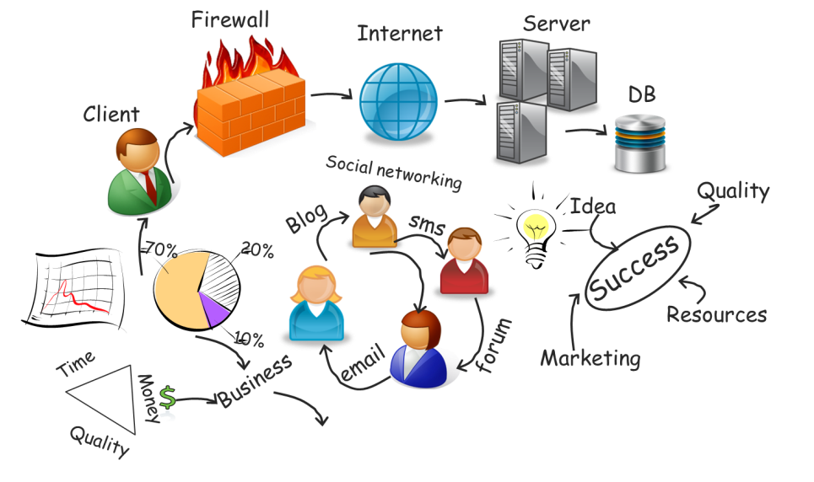

What is Business Intelligence ?
Business Intelligence is the process of transforming the business data into Information/Knowledge using computer based techniques thus enabling the users to take effective fact based decisions
Business Intelligence
Information /Knowledge
Decision
Business Data

Slide 9
Business Intelligence: Decision Making
Identify Problems or Opportunities
Gather Required
Data
Explore Alternatives
Data Analysis, QA
Business Decision

Slide 10
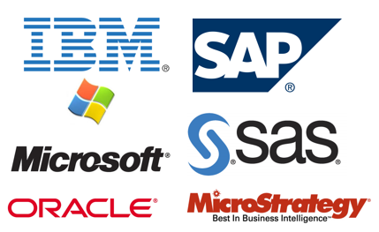
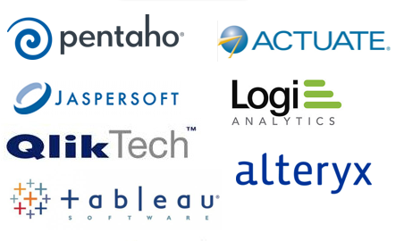
Business Intelligence: Existing Solutions
There are various BI vendors offering end-to-end solutions in the market which can be traditionally classified as:
Large BI Vendors
New Vendors

Slide 11
Questions of Manager!
Lets say if a producer wants to know the following….
Show me the products with high margins
Show my lowest sales among all region
What-if bundling multiple products to increase sales
Show me Top Selling products for past five years
Show me inventory trend for the past 5 years
Increase sales by identifying customer buying pattern

Slide 12
MSBI : Answer to All
Provides a “Single Version of Truth” to make effective
Eliminates or reduces Instinctive /Gut feeling decisions
Quick and timely answers to the business thus making business more responsive to the dynamic business trends
Minimize error prone manual and mundane work
Very rich support for advanced analysis thus making better understanding of their business process, customers and competitors
Support for Historical data
Support for Summarized data thus identifying

Slide 13
MSDN Library
MSDN's primary web presence at msdn.microsoft.com is a collection of sites for the developer team that provides documentation, information, and discussion which is given both by Microsoft and by the team at large
Currently, Microsoft has placed emphasis on incorporation of forums, blogs, library annotations and social bookmarking to make MSDN an open dialog with the developer team rather than a one-way service
You will find well documents steps for all the features available on MSDN for reference along with several blogs available on Business Intelligence which keeps you updated on latest updates and improvements

Slide 14
MSBI Architecture

Slide 15




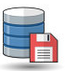



MSBI Architecture
Reports, Scorecards and Dashboard
SSRS - SQL Server Reporting Services
Excel
Cube
SSAS - SQL Server Analysis Services
OLAP
Data Warehouse
SQL
Server
SSIS - SQL Server Integration Services
ETL
Data Sources
Databases
& Files

Slide 16


MSBI : Example
Let’s understand this picture by taking an example of an organization
Let’s take the example :-
is one the most popular brands for apparel and accessories. We have outlets of
in most parts of World

Slide 17

MSBI : Example
Every outlet stores their customer data in their respective database and it’s not mandatory that every outlet is using the same database
Some outlets may have SAP as their database, some might be using Oracle or some stores prefer storing their data in simple text files

Slide 18
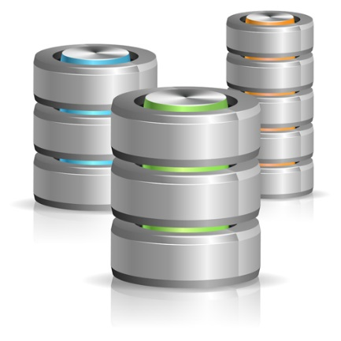
Phase 1: SSIS [Integration Services]
After storing daily data of the customers who visited outlet at different stores, the data is then integrated and saved into a centralized database
It is accomplished with OLTP component of MS SQL Server
Integration means merging of data from different data stores (i.e. it may be a flat file, Excel sheets, SAP, Oracle, etc.), refreshing data in data warehouses and to cleanse data (e.g. -Date format may be different for different outlet’s database, so same format is made to make it even) before loading to remove errors
OLTP

Slide 19

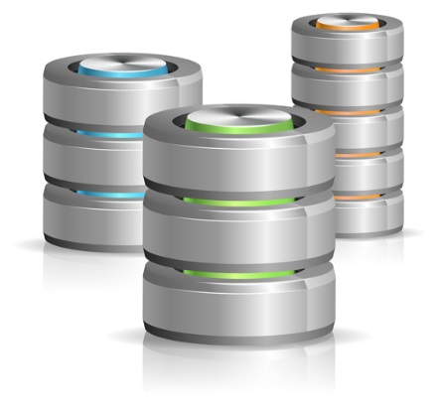
Phase 2: SSAS [Analysis Services]
Next step is to analyse the stored centralized data where in data is divided into Data Marts on which analytic process is done
Analysis services use OLAP (Online Analytical Processing) component and data mining capabilities which as a result gives multi-dimensional structures called CUBES to pre-calculate and store complex aggregations, and also to build mining models to perform data analysis which helps in identifying valuable information like what are the recent trends, patterns, dislikes of customers
Business analyst then perform data mining function on multi dimensional cube structure to look data from different perspectives
OLAP
Multi Dimensional analysis: CUBE

Slide 20

Phase 3: SSRS [Reporting Services]
To gain insights about the analysis, we need get the data graphically visualised so that the company
can make effective decision to enhance their revenue, gain maximum profit and to reduce time wastage
So, this is done in forms of Reports, Scorecards, Plans, Dashboards, Excel workbooks, etc.
These reports will show the organization what is the revenue of in specific time at specific place, where they got hold of the market, in which part they are lacking and where it needs to be enhanced and many other things which end users would like to know about
Mining
Success
Cubes
Reports

Slide 21
BI Platform :SSIS, SSAS & SSRS

Slide 22
Microsoft BI Platform
Search Collaboration Content Management
Share Point Server
Delivery
Reports
Reports
Reports
Reports
Reports
Reports
End User Tools and Performance Management
Excel
Performance Point
Business Intelligence Platform
Analysis Services
Reporting Services
SQL
Integration Services
Database Management
Dynamics
Oracle
SAP
Seibel

Slide 23
Microsoft BI Platform
Search Collaboration Content Management
Share Point Server
Delivery
Reports
Reports
Reports
Reports
Reports
Reports
End User Tools and Performance Management
Excel
Performance Point
Business Intelligence Platform
Analysis Services
Reporting Services
SQL
Integration Services
Database Management
Dynamics
Oracle
SAP
Seibel

Slide 24
SQL Server Database Management
It provides a robust, scalable and enterprise-ready Data Warehouse platform
Microsoft SQL Server has improved partitioning, manageability, and query optimizations to streamline data warehouse operations and increase performance
Many Business Solutions and Systems currently use this database
Business Intelligence Platform
Analysis Services
Reporting Services
SQL
Integration Services
Database Management
Database Management

Slide 25
SQL Server Integration Services
Provides functionality commonly referred to as Extract, Transform, Load (ETL)
Moves and transforms data between sources and destinations, regardless of format
Ensures data integrity and cleanses data in a remarkable format
Integrates heterogeneous data sources
Business Intelligence Platform
Analysis Services
Reporting Services
SQL
Integration Services
Database Management

Slide 26
SQL Server Analysis Services
It allows for Online Analytical Processing (OLAP) which is commonly referred to as “cubes”
It also includes advanced analytical features such as complete data mining and key performance indicator frameworks
It enables organizations to accommodate multiple analytic needs within one solution
Business Intelligence Platform
Analysis Services
Reporting Services
SQL
Integration Services
Database Management

Slide 27
SQL Server Reporting Services
Provides a complete reporting platform so that end-users can view data using a Web browser or desktop
Includes report authoring tools for both technical developers and business users
Allows web-based viewing and rendering in popular document formats such as Microsoft Excel and PDF
Contains robust e-mail subscription capability
Business Intelligence Platform
Analysis Services
Reporting Services
SQL
Integration Services
Database Management

Slide 28
Comparison of MSBI with Other tools

Slide 29



MSBI: Most Reliable Solution
Base Product
Total Cost
$ 25K
Total Cost
$ 40K
Total Cost
$ 25K

Slide 30
MSBI: Most Reliable Solution
Tuning
$ 3K
Diagnostics
$ 3K
Partitioning
$ 10k
Performance
Expert
$ 10k
Microsoft SQL Server
(included)
Manageability
Base Product
Total Cost
$ 25K
Total Cost
$ 56K
Total Cost
$ 35K

Slide 31
MSBI: Most Reliable Solution
MSBI: Most Reliable Solution
DB2 OLAP
$ 35k
DB2 Warehouse
$ 75k
Cube Views
$ 20k
OLAP
$ 20k
Mining
$ 20k
BI Bundle
$ 20k
Business Intelligence
Microsoft SQL Server
(included)
Manageability
Base Product
Total Cost
$ 25K
Total Cost
$ 116K
Total Cost
$ 154.5K

Slide 32
MSBI: Most Reliable Solution
Data Guard
($ 116k)
Recovery
Expert
$ 10k
High Availability
Business Intelligence
Microsoft SQL Server
(included)
Manageability
Base Product
Total Cost
$ 25K
Total Cost
$ 232K
Total Cost
$ 164.5K

Slide 33
MSBI: Most Reliable Solution
$116k- $232k
Multi-Core
$160k- $165k
High Availability
Business Intelligence
Microsoft SQL Server
(included)
Manageability
Base Product
Total Cost
$ 25K
Total Cost
$ 348K- 464K
Total Cost
$ 324K-329K

Slide 34
MSBI: Most Reliable Solution
Total Cost
$ 348K- 464K
Total Cost
$ 324K-329K
Multi-Core
High Availability
Business Intelligence
Total Cost
$ 25K
Manageability
Base Product
Total Cost

Slide 35
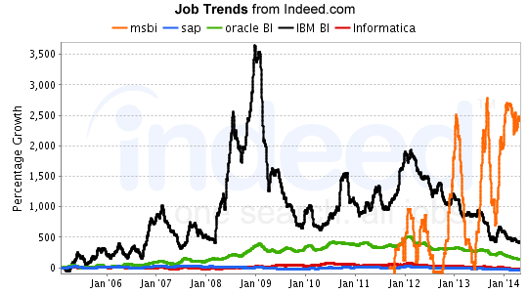
Job trends for MSBI

Slide 36
Demo

Slide 37
Disclaimer
Criteria and guidelines mentioned in this presentation may change. Please visit our website for latest and additional information on MS-BI

Slide 38
Course Topics
Module 1
MSBI and SSIS Architecture Overview
Module 2
SSIS Control and Data Flow
Module 3
SSIS (Transactions, Error Handling)
Module 4
SSIS (Configuration, Deployment and Scheduling)
Module 5
SSIS Advance Topics & DWH Basics
Module 6
SSAS Cube Design
Module 7
SSAS Deployment and MDX, DAX
Module 8
SSRS Reporting Basics
Module 9
SSRS: Report Manager
Module 10
Putting the Pieces Together

Slide 40
References
http://www.indeed.com/jobtrends
Office.com Clip Art/
http://msdn.microsoft.com/en-IN/library/ms141085.aspx

